Slide 1
HW1 Tutorial

Slide 2
Outline
Section 1. BASIC GLUT - About main() function in basicDraw.cpp
1-1 Document
1-2 OpenGL Architecture
1-3 Initialization and window
1-4 Callback Registration
1-5 Geometric Object Rendering
1-6 Beginning Event Processing

Slide 3
Outline
Section 2. BASIC DRAW - About display() function in basicDraw.cpp
2-1 Overview – Code explanation
2-2 Clear color buffer & Clear depth buffer
2-3 Enable depth test
2-4 Draw the triangles
2-5 Complete drawing
2-6 Face culling
2-7 More Information about OpenGL …

Slide 4
Outline
Section 3. BASIC DRAW - How to rotate the planet in OpenGL?
3-1 Overview
3-2 ModelView Matrix
3-3 Modeling Transformation
3-4 Projection Matrix
3-5 Viewport Matrix
3-6 Matrix Stack Mechanism
3-7 Homework
Reference

Slide 5
1.BASIC GLUT About main() function in basicDraw.cpp

Slide 6
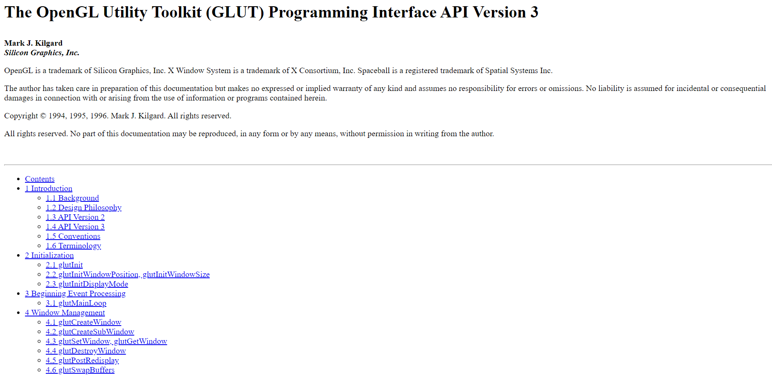
1-1 Document
https://www.opengl.org/resources/libraries/glut/spec3/spec3.html

Slide 7
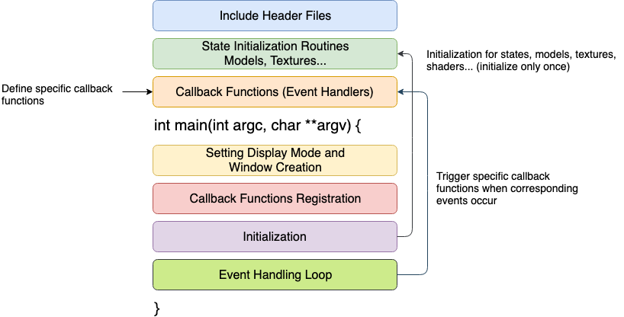
1-2 OpenGL Architecture

Slide 8
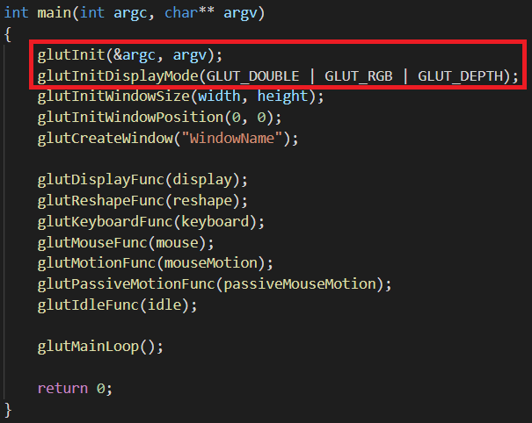
1-3 Initialization and window
void glutInit(int* argc, char **argv);
Initialize the GLUT library
Should be called before any GLUT functions
void glutInitDisplayMode(unsigned int mode); (Red are commonly used parameters)
Specify a display mode for windows created
Color: GLUT_RGBA, GLUT_RGB or GLUT_INDEX
Framebuffer: GLUT_SINGLE or GLUT_DOUBLE
Buffer: GLUT_DEPTH, GLUT_STENCIL and GLUT_ACCUM
Notes:
颜色模式：GLUT_RGBA表示颜色模式，另外还有GLUT_RGB 和 GLUT_INDEX模式。其中GLUT_RGBA为默认的颜色模式。缓冲区类型：GLUT_DOUBLE表示使用双缓冲窗口，与之对应的是GLUT_SINGLE模式，二者的区别是：单缓冲，实际上就是将所有的绘图指令在窗口上执行，就是直接在窗口上绘图，这样的绘图效率是比较慢的，如果使用单缓冲，而电脑比较慢，屏幕会发生闪烁。一般只用于显示单独的一副非动态的图像。双缓冲，实际上的绘图指令是在一个缓冲区完成，这里的绘图非常的快，在绘图指令完成之后，再通过交换指令把完成的图形立即显示在屏幕上，这就避免了出现绘图的不完整，同时效率很高。一般用于生成动画效果。一般用OpenGL绘图使用双缓冲模式。

Slide 9
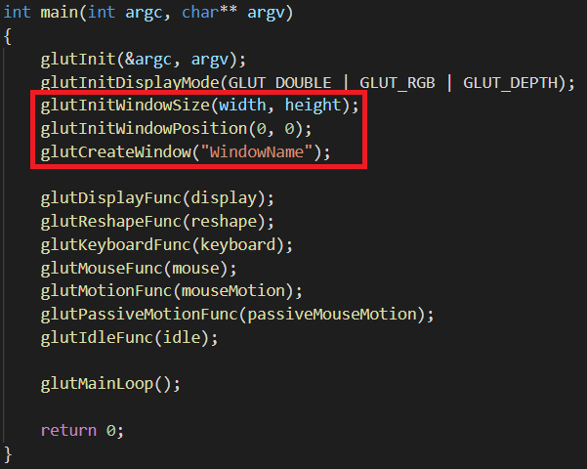
1-3 Initialization and window
void glutInitWindowSize(int width, int height);
Set the initial window size
void glutInitWindowPosition(int x, int y);
Set the initial window position
The actual position is left to the window system to determine
int glutCreateWindow(char *name);
Create and open a window with previous settings

Slide 10
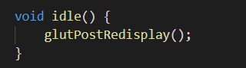
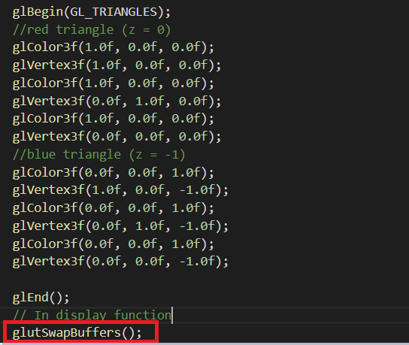
1-3 Initialization and window
void glutPostRedisplay();
Mark the current window as needing to be redisplayed
The window‘s display callback will be called
void glutSwapBuffers();
Swap the buffers of the current window
An implicit glFlush() is done by glutSwapBuffers()

Slide 11
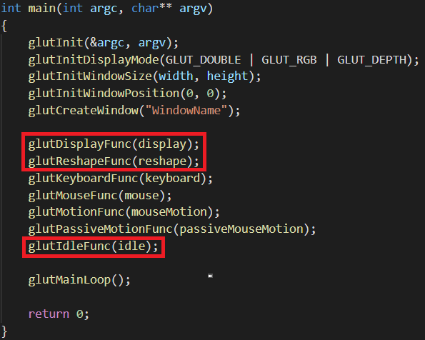
1-4 Callback Registration
void glutDisplayFunc(void (*func)(void));
Put whatever you want to render in the callback
The callback is called when the window need to be redisplayed
Call glutPostRedisplay() to trigger the callback
void glutReshapeFunc(void (*func)(int width, int height));
The callback is called when a window is created, resized or moved
Always call glViewport() to resize your viewport
void glutIdleFunc(void (*func)(void));
Perform background processing tasks or continuous animation when window system events are not being received
The idle callback is continuously called when events are not being received

Slide 12
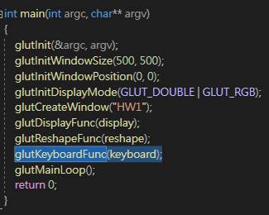
1-4 Callback Registration
void glutKeyboardFunc(void (*func)(unsigned char key, int x, int y));
Each key press generates a keyboard callback
key: The ASCII character generated by the pressed key
x and y: The mouse location in window relative coordinates when the key was pressed

Slide 13
1-5 Geometric Object Rendering
void glutSolidSphere(Gldouble size, GLint slices, GLint stacks);
void glutWireSphere(Gldouble size, GLint slices, GLint stacks);
void gluCylinder(GLUquadric* quad, GLdouble base, GLdouble top,
GLdouble height, GLint slices, GLint stacks);
void glutSolidCube(Gldouble size); void glutWireCube(Gldouble size);
void glutSolidCone(Gldouble size); void glutWireCone(Gldouble size);
void glutSolidTorus(Gldouble size);void glutWireTorus(Gldouble size);
void glutSolidTeapot(Gldouble size); void glutWireTeapot(Gldouble size);

Slide 14
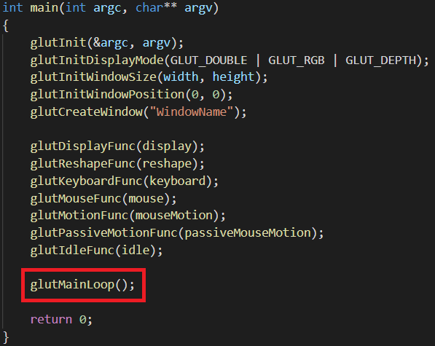
1-6 Beginning Event Processing
void glutMainLoop();
Enter the GLUT event processing loop
Once called, this routine will never return

Slide 15
2.BASIC DRAW
About display() function in basicDraw.cpp

Slide 16
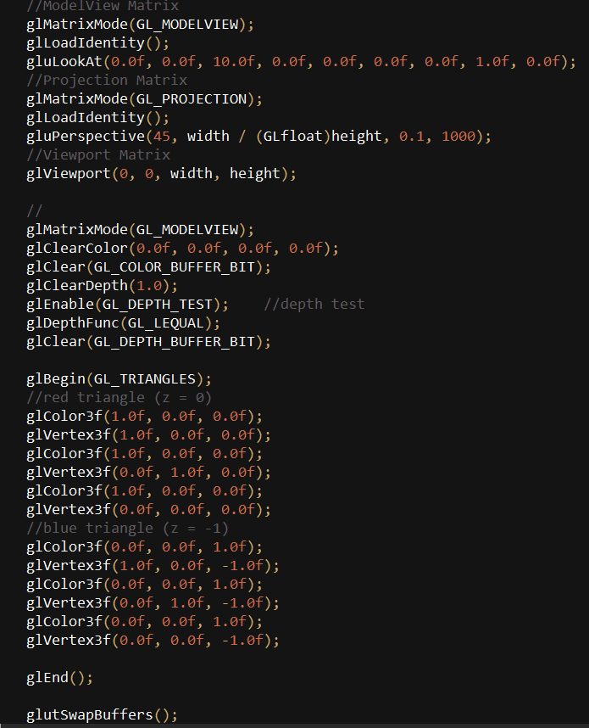
2-1. In the function display() of basicDraw.cpp,
We do the following things,
Set up the MVP matrix (Mentioned later in the Section. 3
OpenGL-Transform)
Before drawing, we need to clear the color buffer and depth buffer by glClear() with the values set by glClearColor() and glClearDepth()
Enable the option for depth test so the face behind other faces would not render in the front
Draw two triangles by glColor3f() and glVertex3f() between glBegin(), glEnd()
In the end, swap the buffers by glutSwapBuffers()
In the next pages, we will introduce the openGL functions
used in these steps since step2. And if you want to know
more detailed information about the functions, please go to
the link:
https://www.khronos.org/registry/OpenGL-Refpages/gl2.1/
STEP1
STEP2
STEP3
STEP4
STEP5

Slide 17
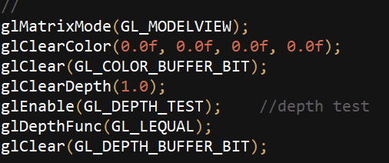
2-2. Clear color buffer & Clear depth buffer
Before we start a new render iteration, we need to clear our
color buffer and depth buffer, otherwise you're stuck with the written color values and depth values from the last render iteration.
Here are the functions used for buffer cleaning:
void glClearColor( GLfloat red,
GLfloat green,
GLfloat blue,
GLfloat alpha);
Specify the red, green, blue, and alpha values used when the color buffers are cleared. The initial values are all 0. (black)
void glClearDepth( GLdouble depth);
Specify the depth value used when the depth buffer is cleared. The initial value is 1. The depth is in the range [0, 1].
void glClear( GLbitfield mask);
Clear the specified buffers to their current clearing values selected by glClearColor(), glClearDepth(), and glClearStencil().
mask: GL_COLOR_BUFFER_BIT, GL_DEPTH_BUFFER_BIT,
GL_STENCIL_BUFFER_BIT
EX:
glClear(GL_COLOR_BUFFER_BIT |GL_DEPTH_BUFFER_BIT);

Slide 18
2-3. Enable depth test
In order to prevent faces rendering to the front while they're behind other faces, we need to enable depth test before drawing:
Here are the functions for enabling depth test:
glEnable(GL_DEPTH_TEST);
When depth test is enabled, OpenGL tests the depth value of a fragment against the content of the depth buffer. If this test passes, the depth buffer is updated with the new depth value. If the test fails, the fragment is discarded.
void glDepthFunc(GLenum func);
Specify the depth comparison function for the depth test.
func: GL_NEVER, GL_LESS, GL_EQUAL, GL_LEQUAL, GL_GREATER... The initial value is GL_LESS
Ex. glDepthFunc(GL_LEQUAL); =>
if (fragment's depth value <= stored depth value) pass.
If you are interested in more information about depth test:
https://learnopengl.com/Advanced-OpenGL/Depth-testing

Slide 19
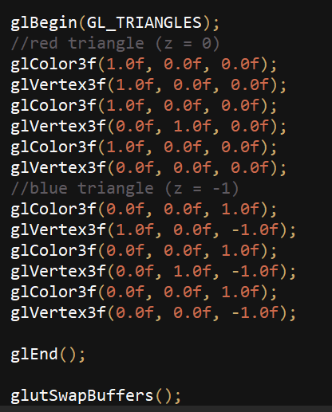
2-4. Draw the triangles
By the help of OpenGL, we can draw our triangles by
simply setting the vertex data between glBegin() and
glEnd()
void glBegin(Glenum mode);
Marks the beginning of a vertex-data list.
Vertex-data include vertex’s color, normal, position, etc.
The mode specifies the primitive or primitives that will be created from vertices presented between glBegin() and glEnd().
void glEnd();
Marks the end of a vertex-data list

Slide 20
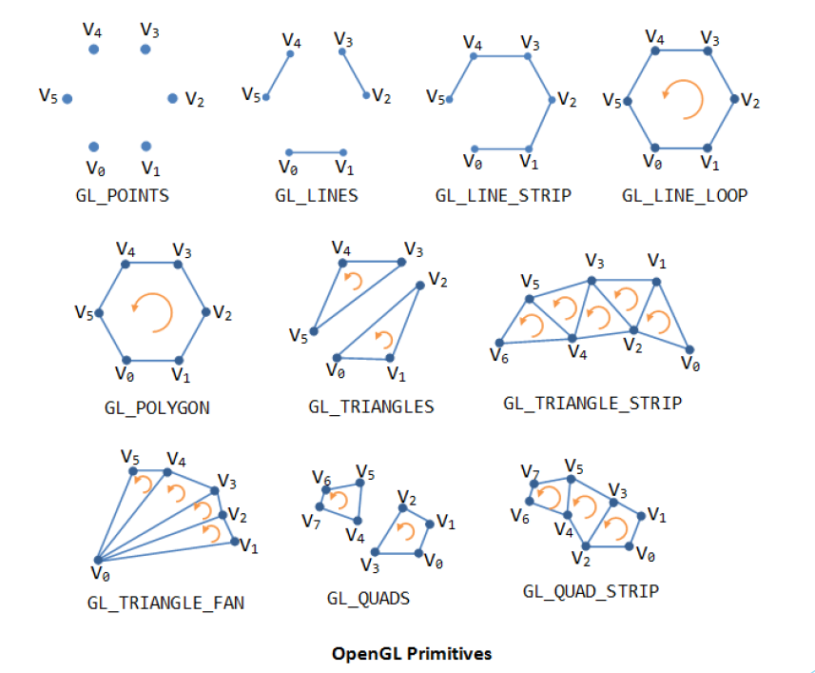
2-4. Draw the triangles
mode of glBegin() :

Slide 21
2-4. Draw the triangles
Can only be effective between glBegin() and glEnd() pair
void glColor{34}{sifd}[v](…);
Set the current color
void glMaterialfv( GLenum face,
GLenum pname,
const GLfloat *params);
Specify material parameters for the lighting model
(If HW1 use lighting, use this to set the color!)
void glNormal3{bsifd}[v](…)
Set the current normal vector
void glVertex{234}{sifd}[v](…)
Specify a vertex for use in describing a geometric object
You have to set vertex’s attributes before glVertex
Ex: Use glColor() and glNormal() before glVertex() to set the
vertex’s color and normal.

Slide 22
2-5. Complete drawing
Don’t forget to swap the buffers when you complete drawing
void glutSwapBuffers();
Swap the front and back buffers.

Slide 23
2-6 Face culling
OpenGL checks and renders all the faces that are front facing towards the viewer while discarding all the back face.
glEnable(GL_CULL_FACE);
Enable OpenGL's GL_CULL_FACE option.
void glCullFace (GLenum mode)
Specify whether front or back facing faces can be culled.
mode: GL_BACK,GL_FRONT,GL_FRONT_AND_BACK
Ex. glCullFace(GL_BACK) culls only the back faces. OpenGL allows us to change the type of face that we want to cull as well.
void glFrontFace (GLenum mode);
Define front and back facing polygons
mode: GL_CW, GL_CCW. The default value is GL_CCW.
Ex. glFrontFace(GL_CCW) =>counter-clockwise ordering
A
A - C - B
Counter-clockwise
C
B
A
A - B - C
Clockwise
C
B

Slide 24
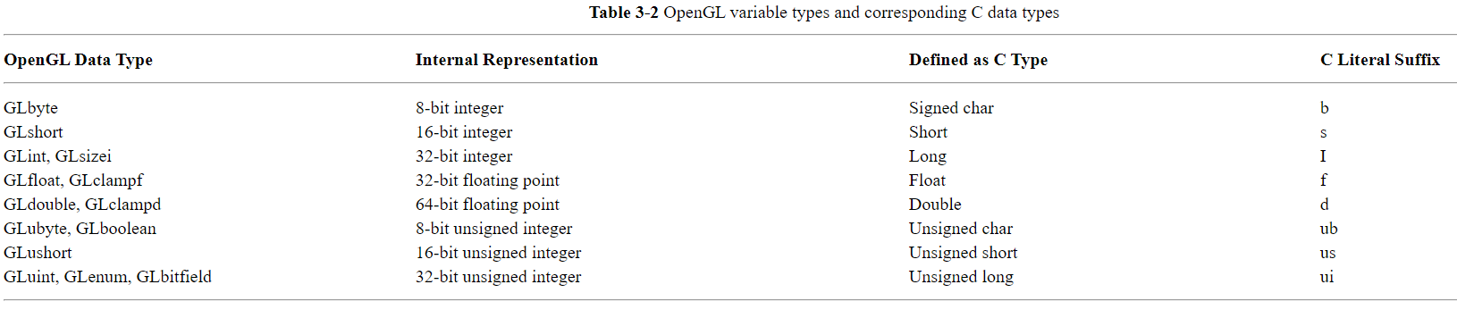
2-7 More Information about OpenGL …
OpenGL data type

Slide 25
2-7 More Information about OpenGL …
OpenGL coordinate system
+Y
Right-handed system
-Z
-x
+x
+Z
-Y

Slide 26
OpenGL-Transform How to rotate the planet in OpenGL?

Slide 27
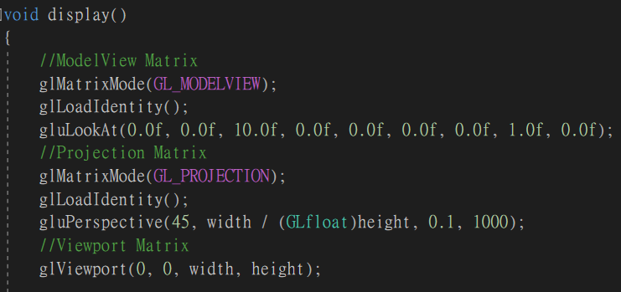
3-1 Overview
Vertex
Modeling Transformation
Viewing Transformation
Projection Transformation
Normalization and Clipping
Viewport Transformation

Slide 28
3-2 ModelView Matrix
void glMatrixMode (GLenum mode);
There are three different modes : GL_MODELVIEW, GL_PROJECTION, or GL_TEXTURE.
Each mode has its corresponding matrix stack, and only one matrix stack is active at a time.
void glLoadIdentity (void);
Replace the current matrix with the identity matrix.
void gluLookAt (GLdouble eyex, GLdouble eyey, GLdouble eyez, GLdouble centerx, GLdouble centery, GLdouble centerz, GLdouble upx, GLdouble upy, GLdouble upz);
Viewing direction is from (eyex, eyey, eyez) to (centerx, centery, centerz).
Camera’s up vector is (upx, upy, upz).
Changing the parameters in gluLookAt() means changing the
camera’s position, not the object’s position.
Up vector
(upx, upy, upz)
Look at the point
(centerx, centery, centerz)
Camera position
(eyex, eyey, eyez)
Notes:
眼睛、物體、頭腦位置
Up vector反過來表示倒立著看

Slide 29

3-3 Modeling Transformation
void glTranslate{fd} (TYPE x, TYPE y, TYPE z);
It will translate the object’s vertices by the given x, y, z values.
Current Matrix
Object’s vertices (x1,y1,z1)
Current Matrix
glTranslate Matrix
Object’s vertices (x1,y1,z1)
y
y
glTranslate(2, 1, 0)
(2, 1, 0)
x
x
(0, 0, 0)
z
z

Slide 30

3-3 Modeling Transformation
void glScale{fd}(TYPE x, TYPE y, TYPE z);
It will scale the object along the x, y, or z axes.
Current Matrix
Object’s vertices (x1,y1,z1)
Current Matrix
glScale Matrix
Object’s vertices (x1,y1,z1)
y
y
glScale(0.5, -0.5, 0.5)
x
x
z
z

Slide 31
3-3 Modeling Transformation
void glRotate{fd}(TYPE angle, TYPE x, TYPE y, TYPE z);
It will rotate the object in a counterclockwise direction. The angle parameter is the angle of rotation in degrees. The rotating axis is from the origin to the point (x, y, z).
Current Matrix
Object’s vertices (x1,y1,z1)
Current Matrix
glRotate Matrix
Object’s vertices (x1,y1,z1)
y
y
glRotate(45, 0, 0, 1)
x
x
z
z

Slide 32
3-3 Modeling Transformation
In OpenGL, matrices multiplications are in reverse order when applied to the vertices.
………..
glRotate();
glTranslate();
glScale();
Draw();
………..
glRotate
glTranslate
glScale
Draw
(Vertices)

Slide 33
3-4 Projection Matrix --- Perspective Projection
glMatrixMode(GL_PROJECTION);
glLoadIdentity();
void gluPerspective (GLdouble fovy, GLdouble aspect, GLdouble near, GLdouble far);
fovy : the angle of the field of view in the y direction.(in degrees)
aspect : the aspect ratio(w/h) that determines the field of view.
near : the distance between the viewer to the near clipping plane(always positive).
far : the distance between the viewer to the far clipping plane(always positive).
aspect=w/h
fovy
w
h
near
far

Slide 34
3-4 Projection Matrix --- Orthographic Projection
void glOrtho (GLdouble left, GLdouble right, GLdouble bottom, GLdouble top, GLdouble near, GLdouble far);
left, right : the coordinates of the left and right vertical clipping planes.
bottom, top : the coordinates of the bottom and top horizontal clipping planes.
near, far : the coordinates of the near and far depth clipping planes.
left
right
top
bottom
near
far

Slide 35
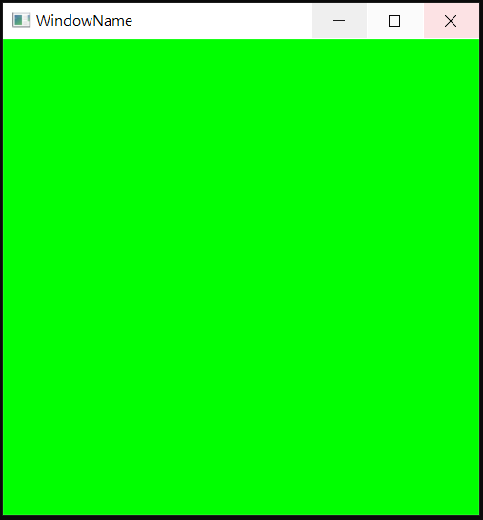
3-5 Viewport Matrix
void glViewport (GLint x, GLint y, GLsizei width, GLsizei height);
Map the final image to some region of the window.
The point (x, y) : the lower-left corner of the viewport rectangle. (in pixel)
width, height : the size of the viewport rectangle.
default value : ( 0, 0, windowWidth, windowHeight )
windowWidth and windowHeight are the size of the window.
windowWidth
y
width
Final image
windowHeight
height
(x, y)
x
(0, 0)

Slide 36
3-6 Matrix Stack Mechanism
You can store certain transformation matrix on the matrix stack and easily get it when you want to reuse.
The top of the matrix stack is the current matrix.
Use glPushMatrix() and glPopMatrix() to manage the stack.
void glPushMatrix() :
Push the current matrix on the top of the stack.
void glPopMatrix() :
Pop the top matrix off the matrix stack.
Current matrix
Current matrix
Current matrix
B
C
Current matrix
B
Push
B
B
Pop
B
A
A
A
A
Matrix stack
Matrix stack
Matrix stack
Matrix stack

Slide 37
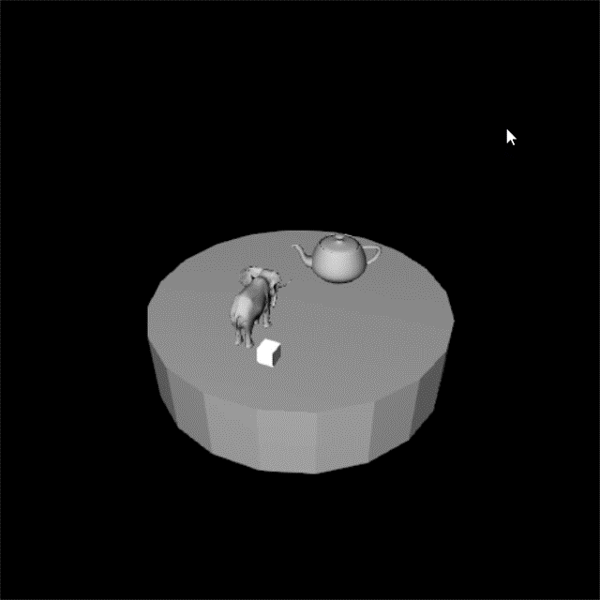
3-7 Homework 1 - Music Box

Slide 38
3-7 Homework 1
Camera:
position: (20, 20, 20)
center: (0, 0, 0)
up vector: (0, 1, 0)
Fovy: 60
Near: 1.0
Far: 1000.0
整體轉速:
旋轉軸: y軸
1 degree/frame
(逆時鐘)
Cube & Elephant 轉速:
旋轉軸: y軸
3 degree/frame
(逆時鐘)
Cube 縮放:
0.5 倍(長/寬/高)

Slide 39
3-7 Homework 1 (Basis)
edge = 20
radius = 10

Slide 40
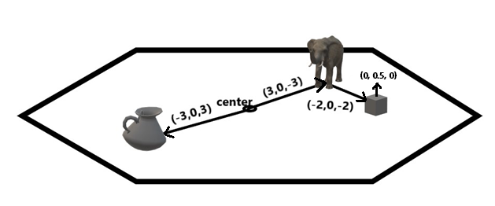
3-7 Homework 1 (相對位置)

Slide 41
3-7 Homework 1 (配分)
Enable DepthTest (5%)
Add lighting, Viewport Matrix, Projection Matrix and ModelView Matrix (10%)
(light is correct (5%) / glMatrixMode is correct (5%))
Draw Basis (25%)
Load model (5%)
translate (5%) /rotate (5%) / scale (5%) all correct (20%)
Demo – 問問題&改code (20%)
#加分 Set the keyboard control (5%) rotate camera/ object or some what..

Slide 42
3-7 Homework 1 (繳交規則)
DeadLine: 2020/ 10 / 26 23: 59:59
Penalty of 10% of the value of the assignment per late week.
If you submit your homework late, the score will be discounted.
submit between (10/27 - 11/2) : Your final score * 0.9
submit between (11/3 - 11/9) : Your final score * 0.8
submit after 11/9 : Your final score * 0.7

Slide 43
Reference
https://www.khronos.org/registry/OpenGL-Refpages/gl2.1/
https://learnopengl.com/
http://opengl.czweb.org/ch03/031-034.html

